Slide 1
The Philosophy of Surrealism
Stephanie Spoto
Monterey Peninsula College

Slide 2
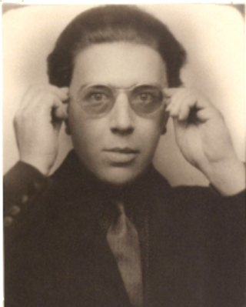
An intellectual, philosophical, artistic movement
Developed after WWI → started in 1924 in Paris with Andre Breton
Artists depicted illogical and unnerving scenes
Aim was the expression of the unconscious mind
Breton: the goal of surrealism is "resolve the previously contradictory conditions of dream and reality into an absolute reality, a super-reality“
Published the Surrealist Manifesto in 1924:
can be applied to all aspects of life (not just art)
Dreams important source for knowledge and inspiration

Slide 3
Surrealist Experimentation
The ethos of Surrealism is one of non sequitur, unexpected pairing/juxtaposition, and surprise
Artists and writers expressed their work as a manifestation of a philosophical movement, foremost (not just aesthetic)
Surrealist works/arts are mere artifacts of surrealist experimentation
Surrealism above all a philosophical and political revolutionary movement → especially associated with anarchism and communism.
Breton: "It was in the black mirror of anarchism that surrealism first recognized itself."

Slide 4
Freud and the Unconscious
Influenced by Dadism and responding to previous philosophies, such as Schopenhauer, Romanticism, and the Enlightenment
Largest contemporary influence was Freud (d. 1939).
The Interpretation of Dreams (1899)
Believed there was a deep layer of the human mind where experience, memory, and basic instincts are stored (the unconscious mind)
Surrealists believed that the unconscious mind could be represented in art, literature, etc.

Slide 5
Illogic and juxtaposition
Breton: "one could combine inside the same frame, elements not normally found together to produce illogical and startling effects.“
Influenced by 1918 essay by Pierre Reverdy: "a juxtaposition of two more or less distant realities. The more the relationship between the two juxtaposed realities is distant and true, the stronger the image will be−the greater its emotional power and poetic reality."
Aim: to create a philosophy and art that would revolutionize human experience (personal, social, cultural, political)
Rationality, and servitude of the id and ego to the super ego → false rationality, restrictive
True aim of Surrealism, Breton: "long live the social revolution, and it alone!"
Lobster Telephone, Dali, 1936

Slide 7
Surrealism and Art
Vladimir Kush

Slide 8
Freud vs. the Surrealists
Freud: dream analysis important because we should use symbolism and psychoanalysis to understand the function of the conscious mind
Balancing the id and the superego in the ego
Surrealists: goal is not to balance the conscious mind → goal to liberate the mind from the superego
For example, Jacques Vaché: the alarm clock is a representation of the superego:
“a monster that has always frightened me because of the regimentation glaring from its face, because of the way it-this honest man-glares at me when I enter the bedroom. [It is] a hypocrite that detests me.”
Jean Miro, Beauty Will Save the World, 1927

Slide 9
Super Ego the logic of time
Franklin Rosemont, co-founder of the Chicago Surrealist Group: alarm/time clock is “at the very center of the class struggle... scientific management.. multiplied profits and the power of the giant trusts.” He then asks, “When will the last ten-thousand alarm-clocks be tossed on a bonfire of the last ten-million time cards?”
Andre Breton: “Human dignity has been reduced to the level of exchange value […] We do not accept the laws of economy and exchange, we do not accept enslavement to work.”

Slide 11
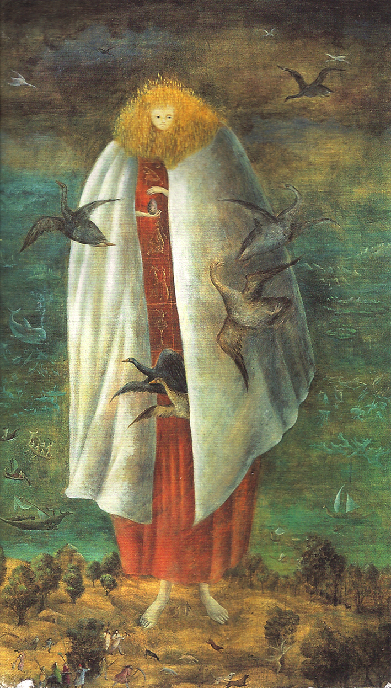
Leonora Carrington
In the interview, Leonora Carrington tells Joanna Moorhead that she’s trying to “intellectualize” art.
How can we understand Carrington’s warning in terms of the philosophy of surrealism?

Slide 12
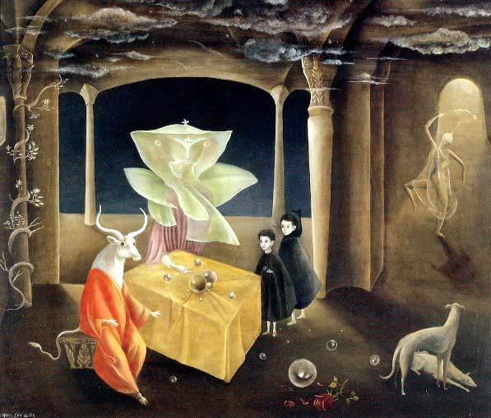
And then we saw the Daughter of the Minotaur!（1953)

